Slide 1
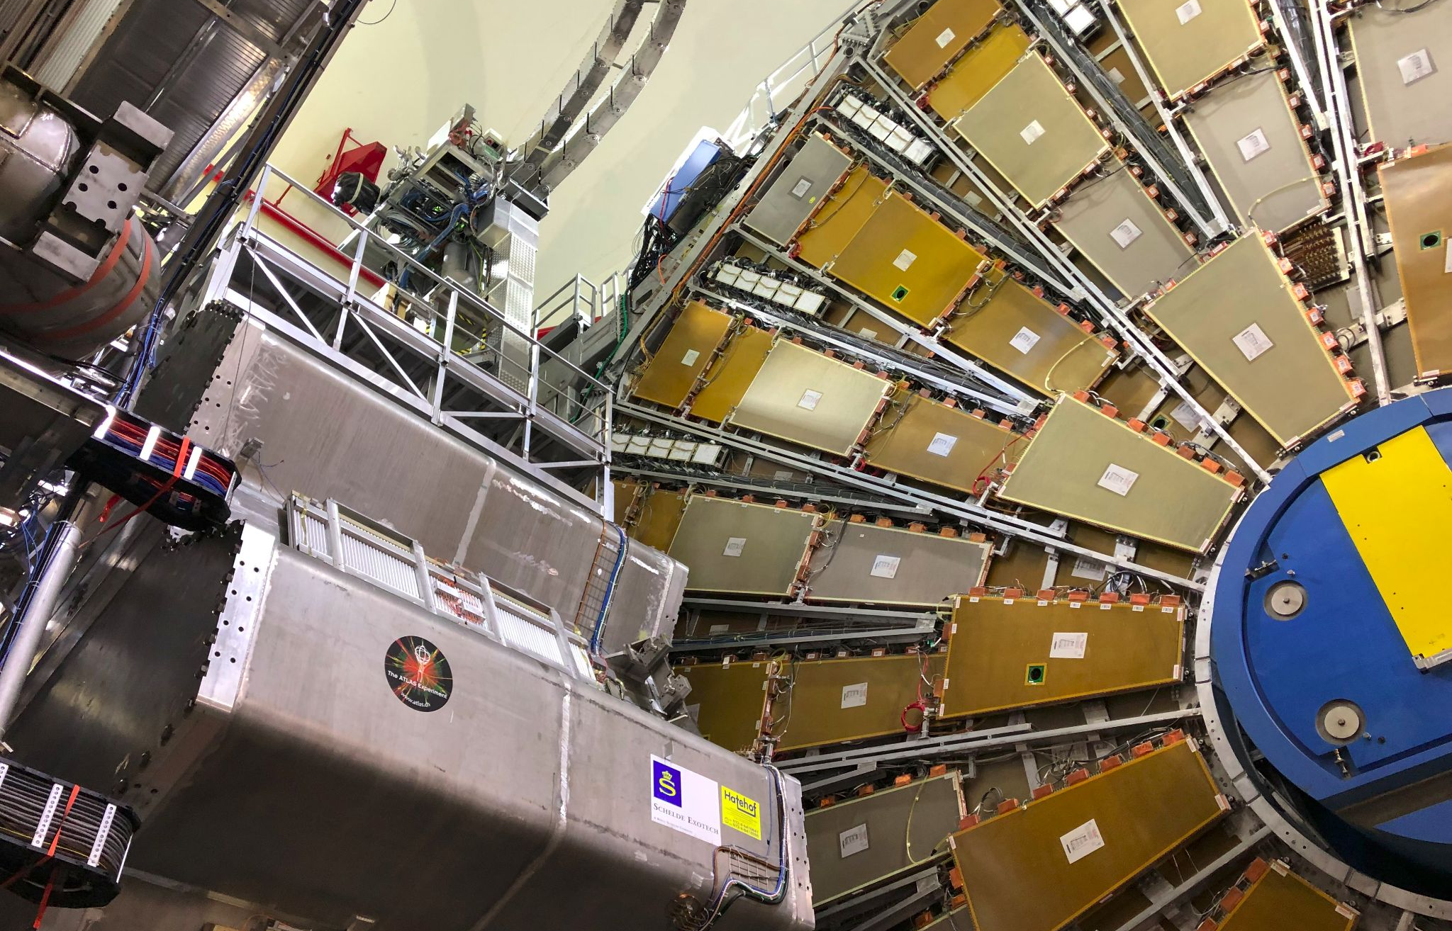

Maintenance Weekly
TileCal Op Meeting, 2 September 2021
Irakli Minashvili, Chris Thomas, Dawit Belayneh, Katie Hughes

Slide 2
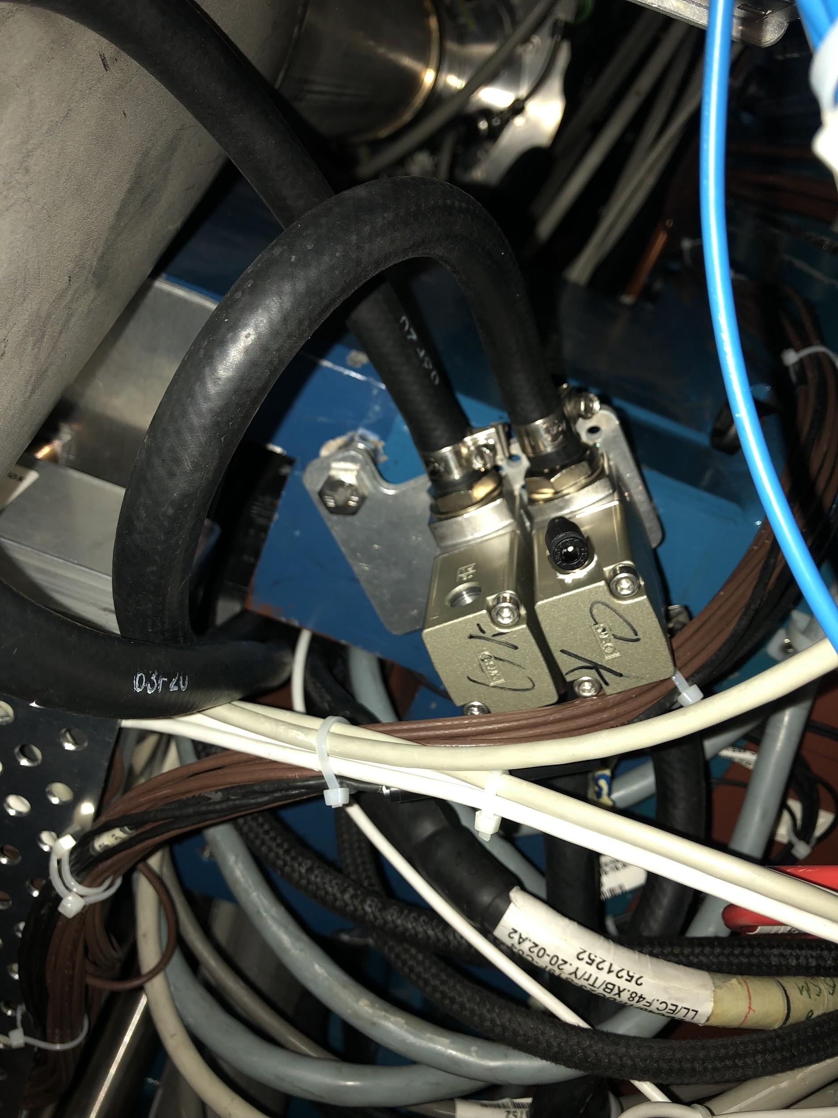
Maintenance Summary
Connected hoses to valves on EBC 46, 47, 48
Will connect 45 and 44 later today
18 April, 2019 LS2 Maintenance Status and Plan
May 2, 2019 LS2 Maintenance Status and Plan
May 30, 2019
2 September 2021

